Slide 1
Environment-Sensitive Cloning in Images
Yun Zhang and Ruo-Feng Tong
College of Computer Science, Zhejiang University
Notes:
Morning everyone.
I am Yun Zhang, from Zhejiang University, under the Prof. Ruo-Feng Tong’s direction, he is also a co-author of this paper.
In this talk, we present a novel cloning technique in images which takes into account the global feature of the target scene.

Slide 2
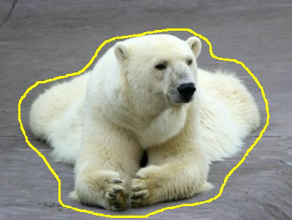
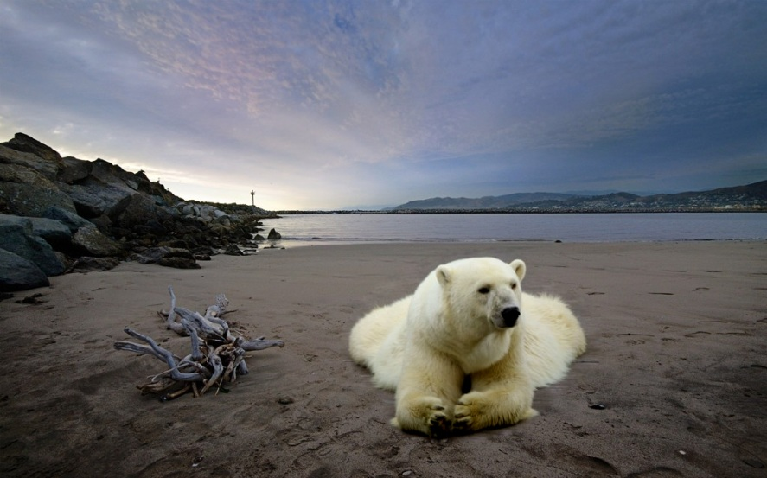
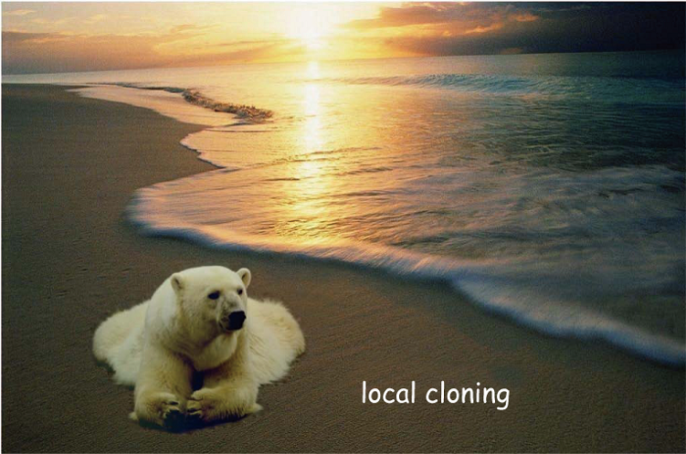


Motivation
Traditional gradient-based cloning can paste a source patch into the target image seamlessly, while ignoring the feature of the target scene.
Notes:
Image cloning, which aims to create a new image by pasting a source patch into the target scene seamlessly and naturally, is a common operation in image editing. First of all, we talk about the motivation. Traditional gradient-based cloning can paste a source patch into the target image seamlessly. Let’s look at the result in the left, the bear is cloned into the beach seamlessly and naturally. However, in the right side, when the bear is cloned to the beach with the sunset, the result is not visual-pleasing.

Slide 3

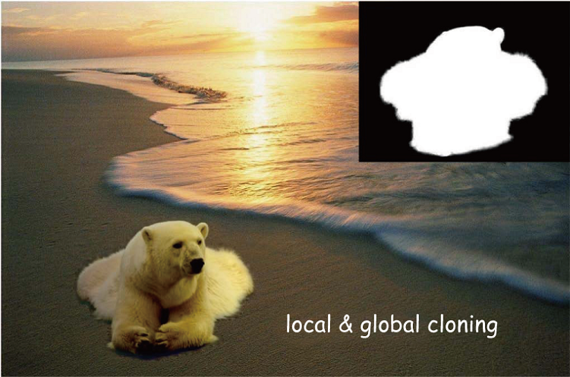

Motivation
We believe that the global feature of the target scene is an important factor for high-quality image cloning.
Notes:
The left image is the cloning result based on simple MVC cloning, we find that it is seamless but unnatural. The right image shows the result using our environment-sensitive cloning method. Compared with the result using direct MVC cloning, our method can remove the visible seam while ensuring that the color appearance of the cloning region is in accord with the target scene, in general, the appearance of the bear should be affected by the sunset in the environment. Thus, we believe that the global feature of the target scene is an important factor for high-quality image cloning.

Slide 4
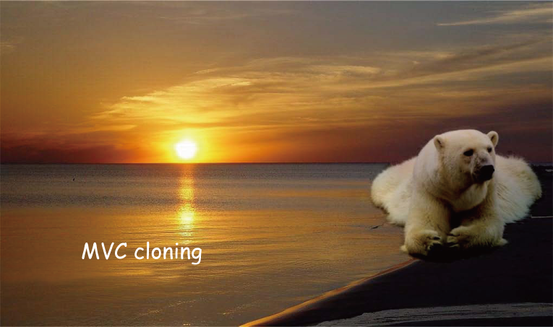
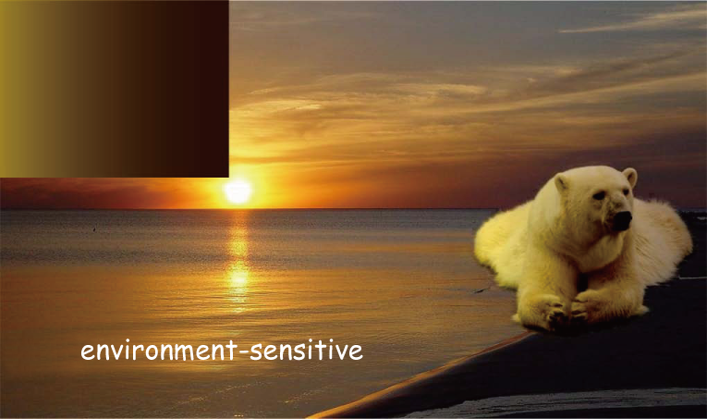


Motivation
Local feature
Local & global feature
Notes:
Most existing methods composite images always considers the local features which can effectively remove the seam on the cloning boundary, e.g. gradient-based cloning. However, we believe that the image patch to be cloned should adjust to the global feature of the target scene, e.g. the illumination condition, so that the cloning result will be more natural and visual-pleasing

Slide 5
Related work
Image Cloning
Gradient-based Cloning [Perez et al. 2003, Farbman et al. 2009, Jia et al. 2009]
Hybrid Cloning [Chen et al. 2009]
Content-aware Cloning [Yang et al. 2010, Ding and Tong 2010, Xie et al. 2010, Lalonde et al. 2007]
None of these methods take into account the global feature of the target scene in image composition.
Notes:
Recently, the gradient domain methods are very popular to perform the seamless cloning. The most famous work is Poisson image editing [SIGGRAPH 03], which involves solving a large sparse linear system. Jia jiaya et al. optimized the cloning boundary to get a better result. Farbman et al. proposed to take the Mean-value coordinates rather than solving a large linear system to perform the image composition, and the performance is advantageous in terms of speed, memory and parallelization. Recent years, a lot of work on image cloning has been done based on the previous work, like cloning with color control and Hybrid cloning and so on. However, none of these methods take into account the global feature of the target scene in image composition.

Slide 6

Challenges
Extract the global feature of the target scene
Represent the extracted global feature and further affect the cloned image
Notes:
The challenges of our work lie in the following two aspects:
How to extract the global feature of the target scene with simple user interaction;
How to make use of the extracted global feature to further affect the cloning result.
Our work focus on dealing with these challenges.

Slide 7
Contributions
Extract and represent the global feature of the target scene
Conceive an efficient method to perform image composition with hybrid boundary
Construct a general model to implement Environment-sensitive cloning
Notes:
Our work has 3 main contributions.
Firstly, we propose a novel method to extract and represent the global feature of the target scene which could be further diffused into the source image patch. A few user interactions are used to extract the global feature according to the illumination clues in the target scene.
Secondly, we conceive a MVC-based approach to perform the image composition with hybrid composition, which largely reduce the time and memory cost compared with Chen’s method in Sketch2Photo.
Lastly, based on our environment-sensitive cloning, we construct a general model to implement image composition by simply setting a few parameters according to the local and global condition for image cloning. Our image cloning method can be further applied to video cloning.

Slide 8
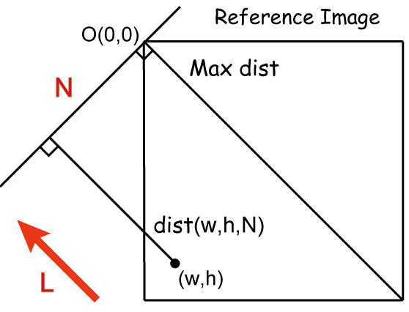
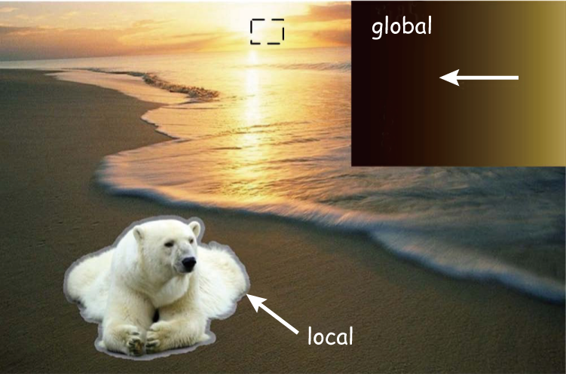
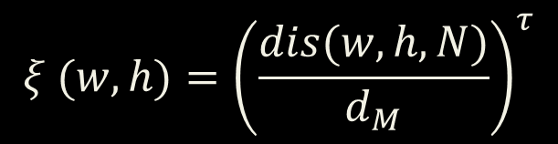
Global Feature Extraction
An intuitive method to extract
and represent the global feature
$$ξ (w, h)={\left(\frac{dis(w,h,N)}{d_{M}}\right)}^{τ}$$
Notes:
First of all, we have to extract the global feature of the target scene, typically the illumination feature. In general, there is no effective method to automatically extract and represent the illumination features. When we observe an image carefully, a lot of clues in the image(e.g. the position of the sun, the shadows on the ground, or the appearance of the existing objects) can tell us the illumination features.
With this in mind, we make use of these clues to extract the illumination feature from the image manually, and create a reference image ξto represent the extracted features, which can further be diffused into the cloned patch by the gradient-based method. The reference image describes the illumination distribution on the source image when there is a prevailing illumination from a certain direction. For example, in this target scene, according to the position of the sunset, the right side of the reference image should be brighter than the left side. This equation computes the lightness of the reference image, which means that the lightness is changed from bright to dark gradually in a certain direction. As for the color component, we select a region in the sunset with a rectangle and then compute the mean value of their color component.

Slide 9


Environment-Sensitive Cloning
Gradient-based method which combines the local and global features
$$f\left(x\right)=g\left(x\right)+R(x)$$
$$R\left(x\right)=α\left(x\right)r_{1}\left(x\right)+(1−α\left(x\right))r_{2}(x)$$
Rough Alpha matte or importance map can represent $α\left(x\right)$
Notes:
Our cloning method combines the local and global features of the target scene. As shown in this Figure, the global feature is represented by a reference image, while the local feature refers to the pixels color on the cloning boundary of the target image.
Now, we talk about the implementation. The essence of the gradient-based cloning is to construct a harmonic interpolant R(x) which diffuses the discrepancies on the boundary of the source and target image into the cloned patch. Thus, the final result can be expressed like this.
For important region of the source image patch whose appearance should be changed to match the target scene, so a larger factor α(x)should be given to the global interpolant. While for regions near the cloning boundary, the visible seam should be smoothly diffused, thus the local interpolant should be given a larger factor.
Since the alpha matte is not used to extract the foreground object, but to control the diffusion. Thus, an accurate alpha matte is unnecessary and the user interaction need not to be precise.

Slide 10
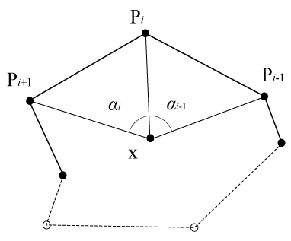


Environment-Sensitive Cloning
Implementation
MVC (Mean-Value Coordinates) [Farbman et al. 2009]
Global Interpolant
Local Interpolant
$$r_{1}\left(x\right)=\sum_{i=0}^{n−1}{λ_{i}(x)\left(ξ\left(P_{i}\right)−g\left(P_{i}\right)\right)}$$
$$r_{2}\left(x\right)=\sum_{i=0}^{n−1}{λ_{i}(x)\left(f^{∗}\left(P_{i}\right)−g\left(P_{i}\right)\right)}$$
Notes:
In terms of implementation, similar to the content-aware image cloning, we prefer to employ the Mean-Value Coordinates to approximate a harmonic membrane without solving a large linear system. The global and local interpolants r1(x) and r2(x) can be expressed by the framework of the MVC.

Slide 11
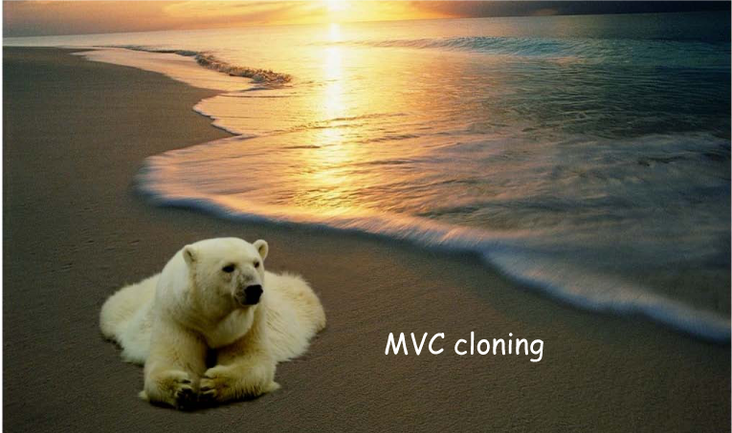
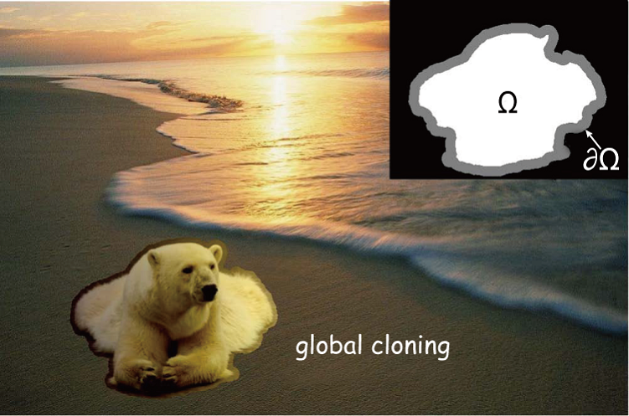
Environment-Sensitive Cloning
Cloning with the local feature
Cloning with the global feature
Notes:
This slice shows us the cloning results using the local and global feature respectively. When the local feature is diffused into the cloned object, the visible seam on the boundary is removed, but the appearance of the bear is not natural in the sunset. However, when the global feature is considered, the bear can take on the effect of the sunset, but the visible seam degrades the cloning result.

Slide 12
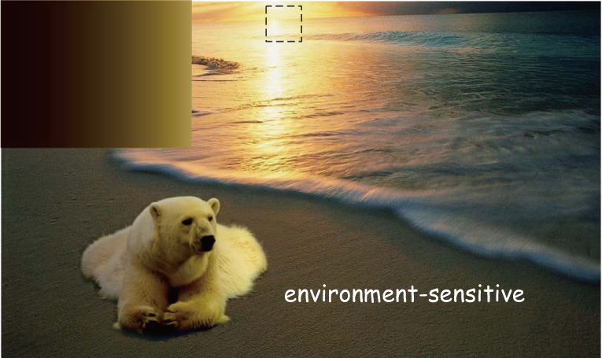
Environment-Sensitive Cloning
Notes:
As a result, we have to combine the advantages of the image cloning using the local and global features. After the combination, we find that our environment-sensitive cloning can produce more acceptable result.

Slide 13


Image Cloning Model
Environment-sensitive cloning guided by the MVC framework
$$f\left(x\right)=g\left(x\right)+\sum_{i=0}^{n−1}{λ_{i}(x)( α\left(x\right)ξ\left(P_{i}\right)+\left(1−α\left(x\right)\right)f^{∗}\left(P_{i}\right)−g\left(P_{i}\right))}$$
$$f\left(x\right)=g\left(x\right)+\sum_{i=0}^{n−1}{λ_{i}(x)( f^{∗}\left(P_{i}\right)−g\left(P_{i}\right))}$$
Standard MVC
Notes:
Combining the local and global interpolants, the final cloning result can be expressed as follows. This equation is not only an implementation our cloning method, but a general model for image cloning. Compared with the standard MVC, the target boundary condition is determined by the combination of reference image ξ and the target image f*. α is used to control the target boundary condition in the following way: the interpolants of pixels with higher αvalue are mainly determined by the reference image. While for pixels with lower α value, their interpolants are influenced by the target image f*. Thus the global feature will be diffused into the important part of the cloned patch, while the region near the cloning boundary will blend with the target image seamlessly.

Slide 14
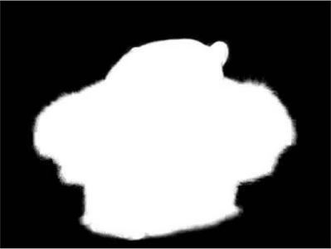
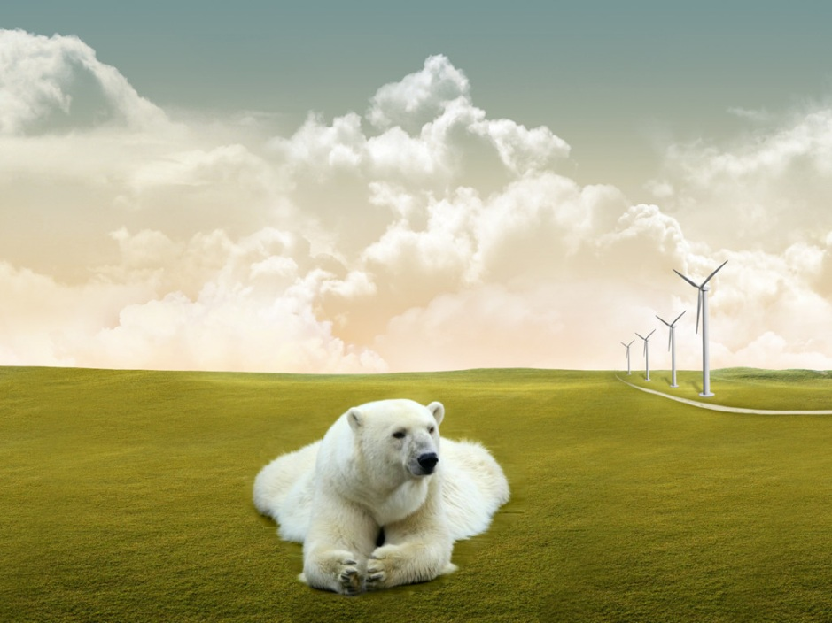
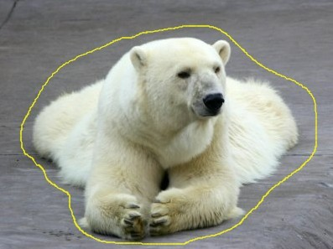




Image Cloning Model
A general model for image cloning
$$f\left(x\right)=g\left(x\right)+\sum_{i=0}^{n−1}{λ_{i}(x)( α\left(x\right)ξ\left(P_{i}\right)+\left(1−α\left(x\right)\right)f^{∗}\left(P_{i}\right)−g\left(P_{i}\right))}$$
$$ξ=g$$
$$α=matte$$
$$\sum_{i=0}^{n−1}{λ_{i}\left(x\right)[(1−α(x))(f^{∗}\left(P_{i}\right)−g(P_{i}))]}$$
Content-aware Cloning [Ding et al. 2010]
Notes:
Now, we discuss the general model for image cloning based on our environment-sensitive cloning. From this equation, we find that this general model can be used for image cloning by setting different ξ and α to meet our specific requirements. For example, when α = 0 or 1 in the cloning area, it becomes original MVC-based cloning using the global or local features. Specifically, when ξ = g, the harmonic interpolant is expressed like this, which becomes the implementation of our content-aware cloning.

Slide 15
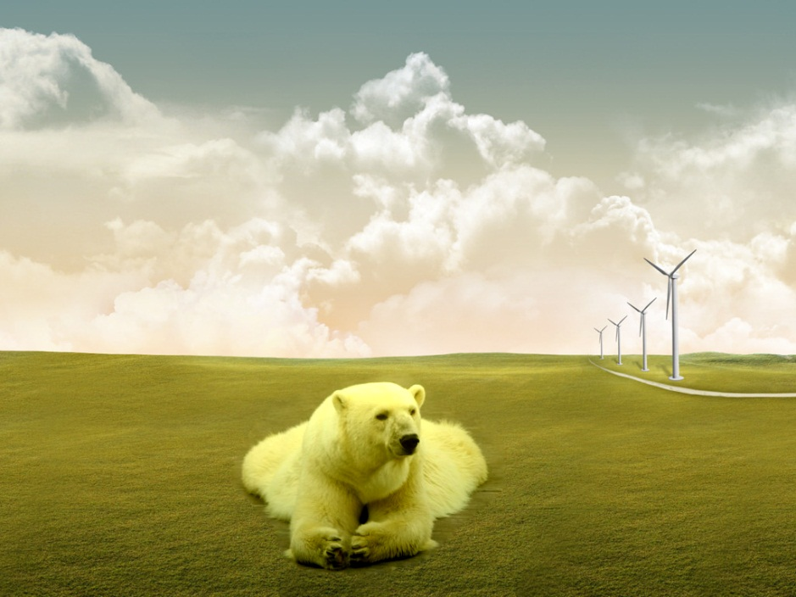




Image Cloning Model
A general model for image cloning
$$f\left(x\right)=g\left(x\right)+\sum_{i=0}^{n−1}{λ_{i}(x)( α\left(x\right)ξ\left(P_{i}\right)+\left(1−α\left(x\right)\right)f^{∗}\left(P_{i}\right)−g\left(P_{i}\right))}$$
$$ξ=g$$
$$α=0$$
$$\sum_{i=0}^{n−1}{λ_{i}\left(x\right)[(f^{∗}\left(P_{i}\right)−g(P_{i}))]}$$
MVC Cloning
Notes:
Similarly, when ξ = g and α=0, the harmonic interpolant is expressed like standard MVC-based cloning.

Slide 16
Image Cloning System
Demo
Notes:
We develop an interactive system for image cloning, which includes alpha blending, content-aware cloning, MVC cloning, and our Environment-sensitive Cloning. As we can see from the system, the user interface is simple and intuitive.

Slide 17

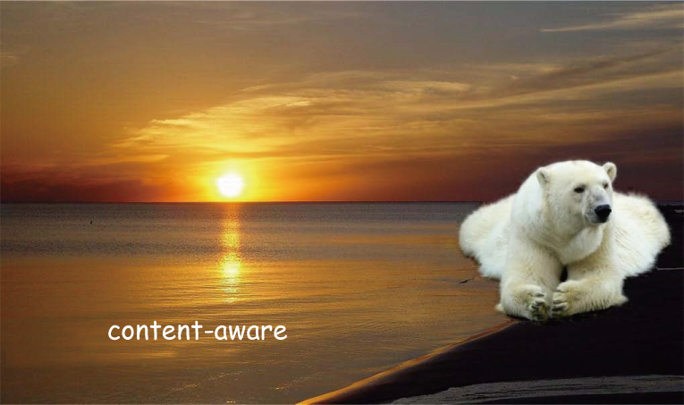

More results
MVC Cloning
Content-aware
Our method
Notes:
Now, we give some results of our environment-sensitive cloning. Here, a bear is pasted into a beach with sunset from its left side. The results show that the quality of cloning result would degrade when ignoring the global feature of the target scene.

Slide 18
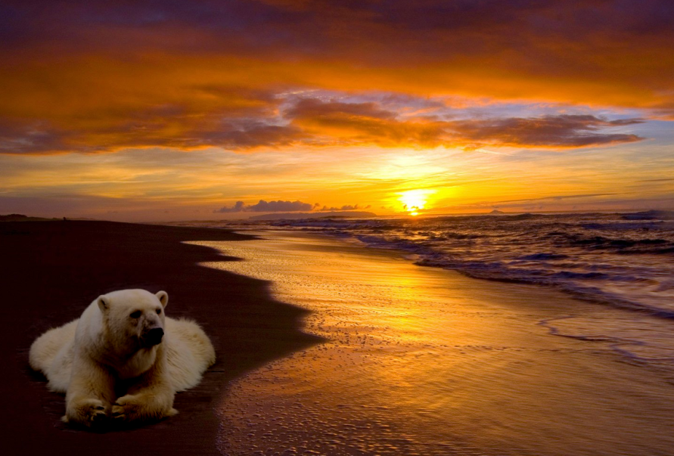
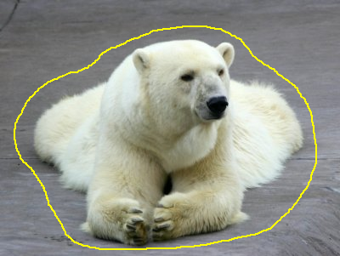
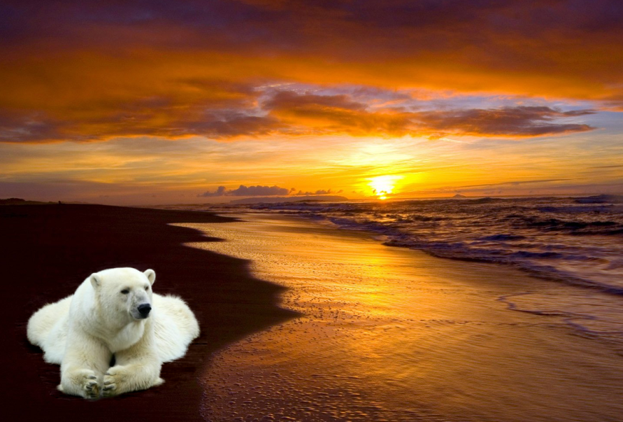
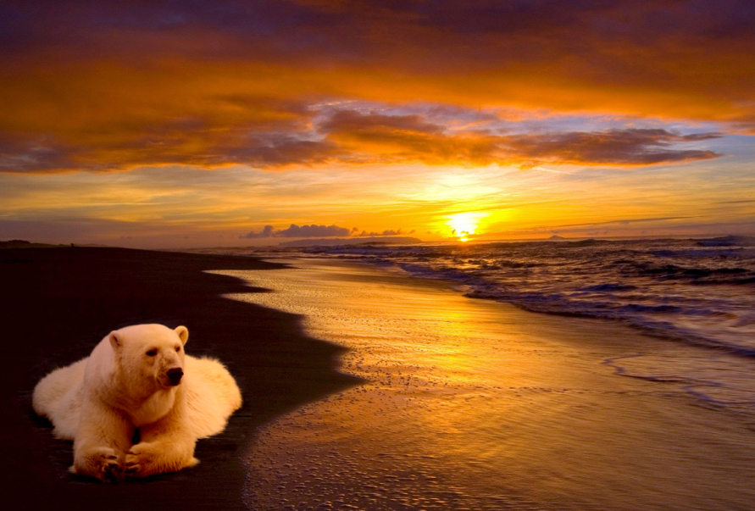
More results
MVC Cloning
Content-aware
Our method(E.S.)
Notes:
And in this example, the same bear is pasted into a beach with sunset from its right side.

Slide 19
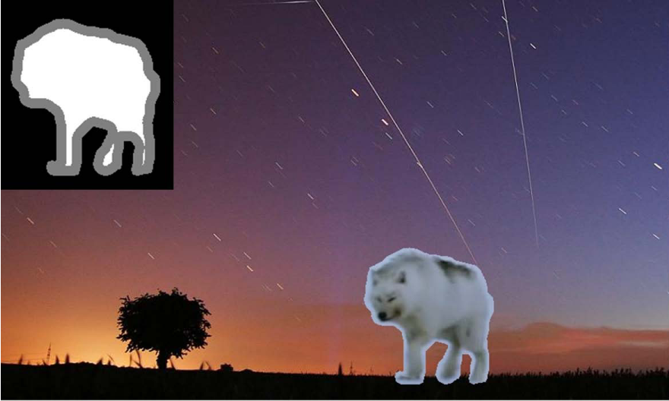
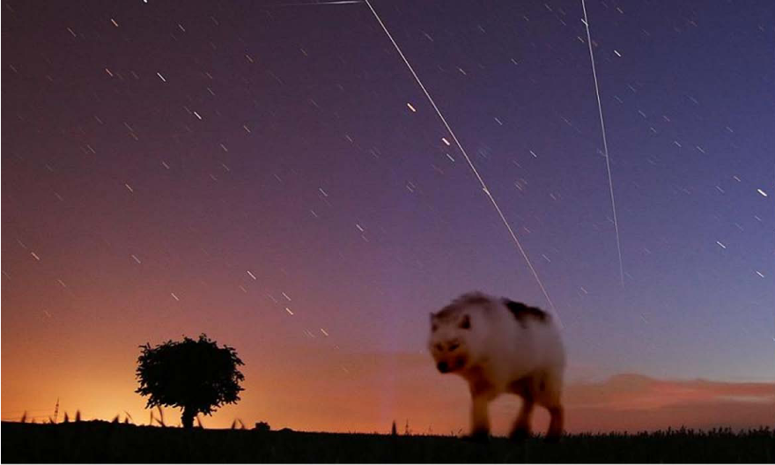
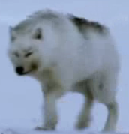
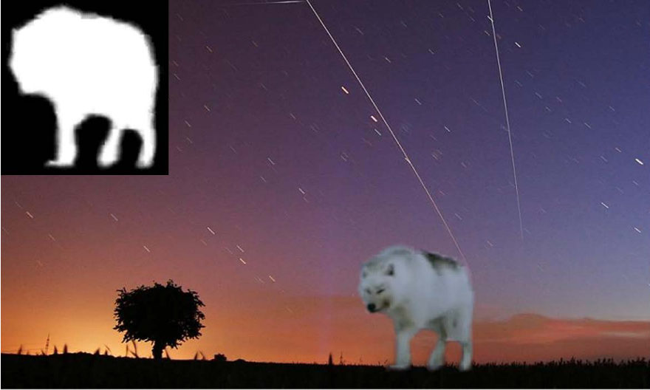
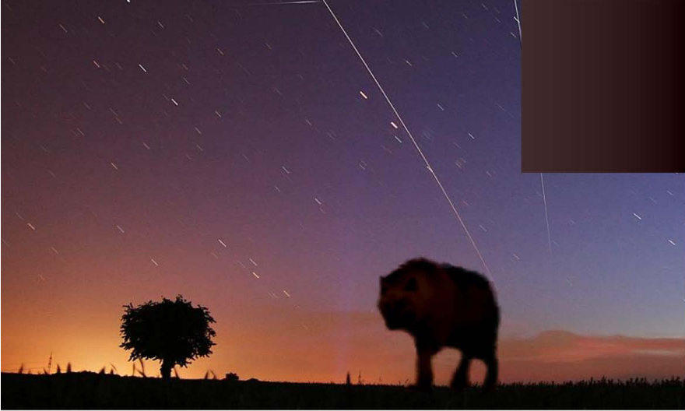
More results
MVC Cloning
Content-aware
Our method(E.S.)
Notes:
This is another result, here the illumination feature is indicated by the existing object in the scene. The color appearance of the tree indicates that the wolf should be as dark as the tree. Although the MVC cloning can produce seamless result, the appearance of the wolf does not adapt to the target scene.

Slide 20
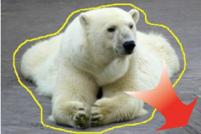
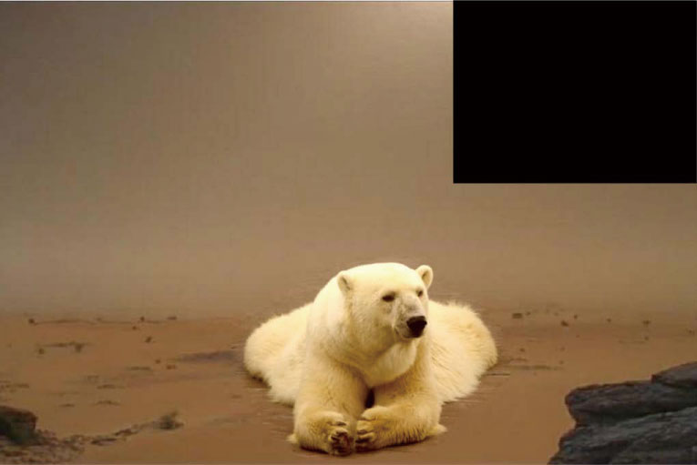
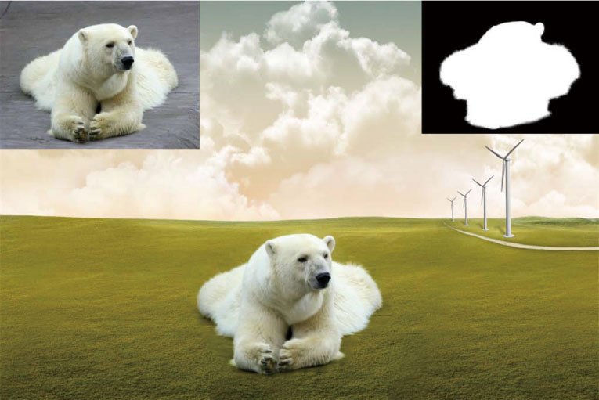
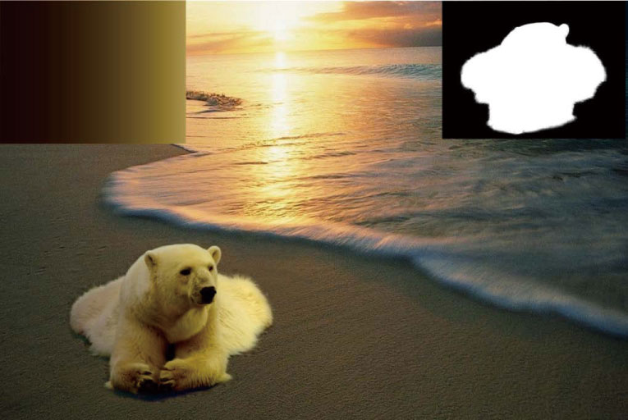
More results
MVC Cloning
Content-aware
Our method(E.S.)
Notes:
Here is some visual appealing results produced by our image cloning model:
The bear is the source image patch;
Set α=0 for all pixels in the cloning region, and the result is the same as the traditional MVC cloning;
Set ξ=g, and the result is the same as the content-aware cloning (the alpha matte is shown in the top-left corner, while the top-right corner is the source image g);
cloning result by our method which considers the global illumination feature (the alpha matte is shown in the top-left corner, while the top-right corner shows the reference image ξ)

Slide 21
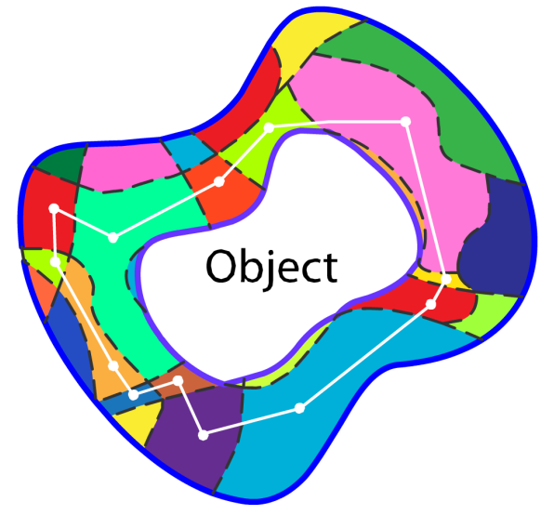
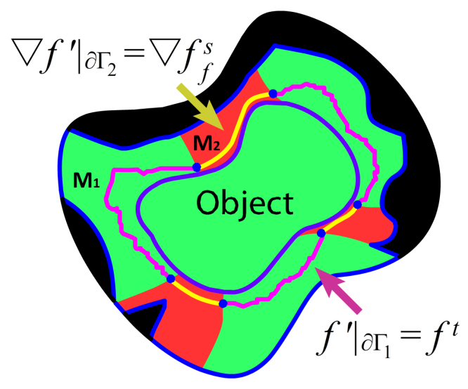
MVC-based Hybrid Cloning
[Chen et al. 2009] proposed hybrid cloning in sketch2Photo
Pixels near the cloning boundary are classified into M₁(consistent color and texture) and M₂(inconsistent color and texture)
Notes:
Now, I begin to introduce our MVC-based image cloning with hybrid boundary. Chen et al. proposed hybrid cloning in Sketch2Photo. He classified pixels near the cloning boundary into two types: M1(the green region) where the texture and color between the source and target are consistent, and M2(the red region) refers to the inconsistent region.

Slide 22



MVC-based Hybrid Cloning
Image cloning with hybrid boundary
Chen et al. calculate the cloning result by solving a Poisson equation with hybrid boundary condition
M1 – Dirichlet boundary condition
M2 – Neumann boundary condition
However, solving a Poisson equation is time and memory consuming
$Δf^{′}=div v over Ω$, with
$$f^{′}|_{M_{1}∩∂Ω}=f^{t} and ∇f^{′}|_{M_{2}∩∂Ω}=∇f_{f}^{s}$$
Notes:
In M1 region, direct Poisson blending is used by solving a Poisson equation with the Dirichlet boundary condition, while in M2, the Poisson equation is solved with the Neumann boundary condition. Thus, the cloning result is calculated by solving a Poisson equation with the hybrid boundary condition. The equation is expressed like this. As we know, solving a Poisson equation is time and memory consuming, our work focuses on finding an efficient method to perform the hybrid cloning.

Slide 23
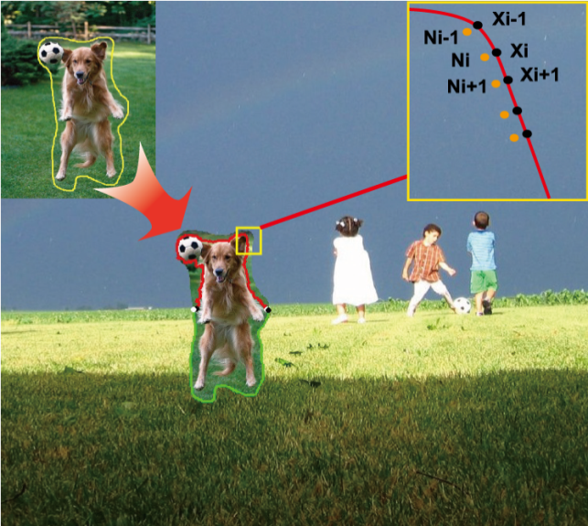



MVC-based Hybrid Cloning
Convert Poisson equation into Laplacian equation
Calculate the pixel values of target image on the Neumann boundary
$$f^{′}=g+\tilde{f}$$
$$∆\tilde{f}=0 over Ω with$$
$$\tilde{f}|_{M_{1}∩∂Ω}=f^{t}−g and ∇\tilde{f}|_{M_{2}∩∂Ω}=0$$
Notes:
Similar to our image cloning framework, our method is based on the MVC framework. We first convert the Poisson equation to Laplacian equation to form the Mean-value membrane interpolation problem, and the mixed boundary condition is also modified appropriately. Then we calculate the pixel values of the target image on the Neumann boundary using the undermined coefficient method.

Slide 24
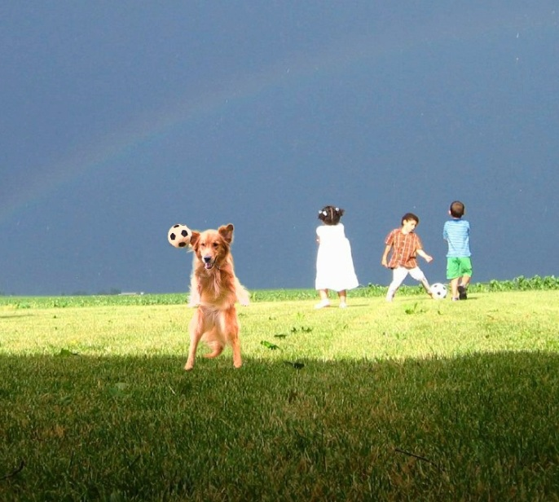

MVC-based Hybrid Cloning
Configure a small linear system and get the boundary value of target image
Substitute the pixel values on the
Neumann boundary, and get the final result using
Mean-value Coordinates
$$x_{i}−\sum_{p∈M_{1}∩∂Ω}{ω_{i}\left(p\right)\left(f^{t}\left(p\right)−g\left(p\right)\right)−}$$
$$\sum_{q∈M_{2}∩∂Ω}{ω_{i}\left(q\right)\left(x_{q}−g\left(q\right)\right)}=0$$
Notes:
For the boundary pixels with Neumann boundary condition, we only know their first derivative, and their values are unknown. We first replace these unknown values with undermined coefficients x1,x2, …. Then we calculate the MVC interpolation of the points n1, n2, … which are on the neighbor of the x1,x2, …. Thus the values of n1, n2 are a linear combination of x1, x2, ….
Next, a small linear system can be figured out according to the Neumann boundary condition.
At last, we substitute the pixel values on the Neumann boundary, and get the final result using the Mean-value Coordinates
Here is the final cloning result with hybrid boundary, after the following comparisons, we can find that it is more natural.

Slide 25

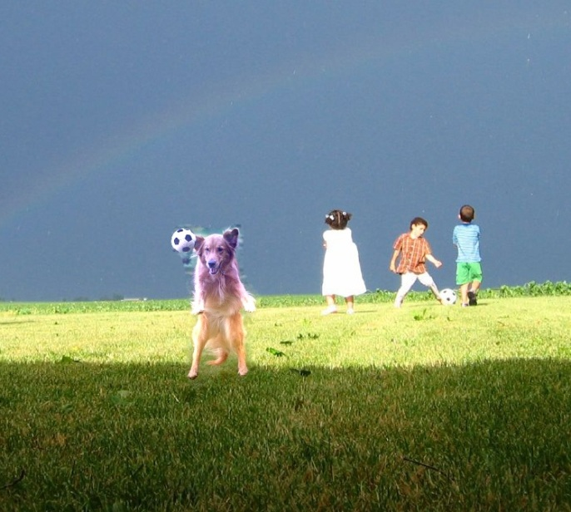
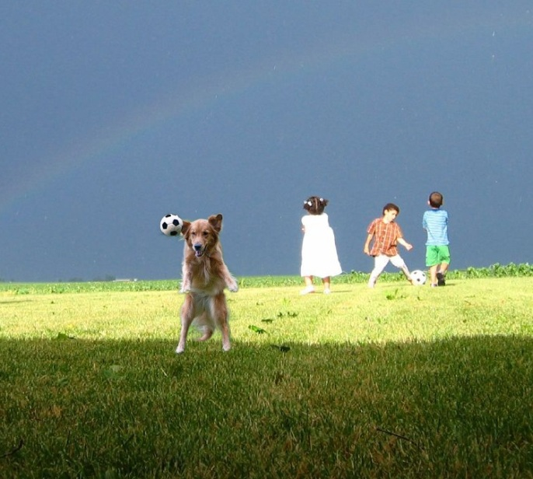
Results of Hybrid Cloning
MVC Cloning
Content-aware
Hybrid Cloning
Notes:
Now we show the cloning results with the hybrid boundary condition.
We paste a dog on the grass, when we paste it directly using MVC cloning, there is artifacts in the air, because the texture and color difference is large in the air.
The content-aware cloning removes the artifacts in the air region by introducing the alpha matte, but it looks unnatural, because it does not adjust to the global environment.
Finally, our hybrid cloning can produce more natural results than previous gradient-based method. In addition, the time and memory cost are largely reduced compared with solving a Poisson equation with the hybrid boundary.

Slide 26
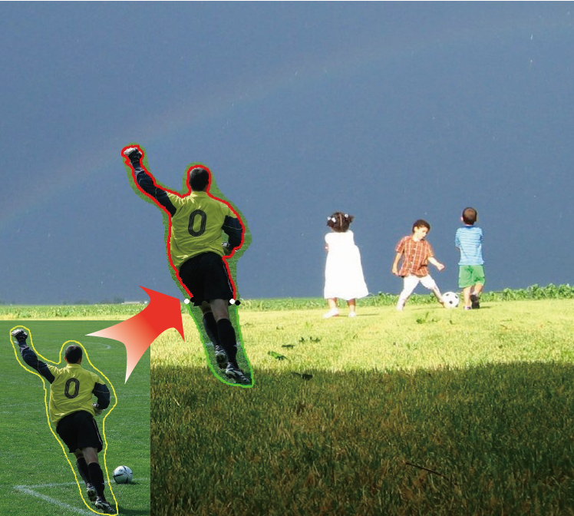
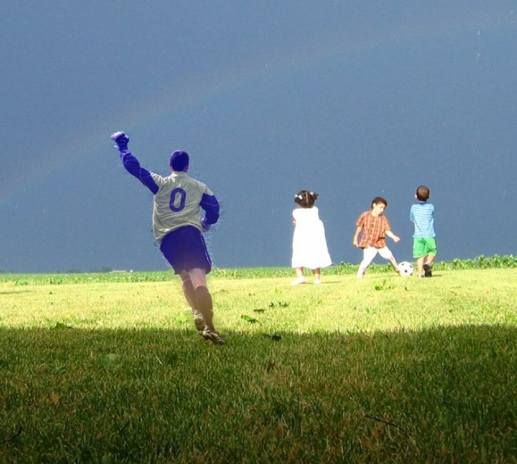
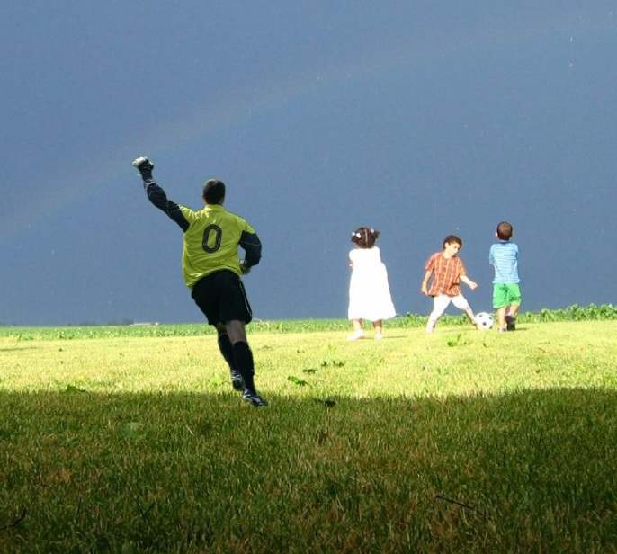
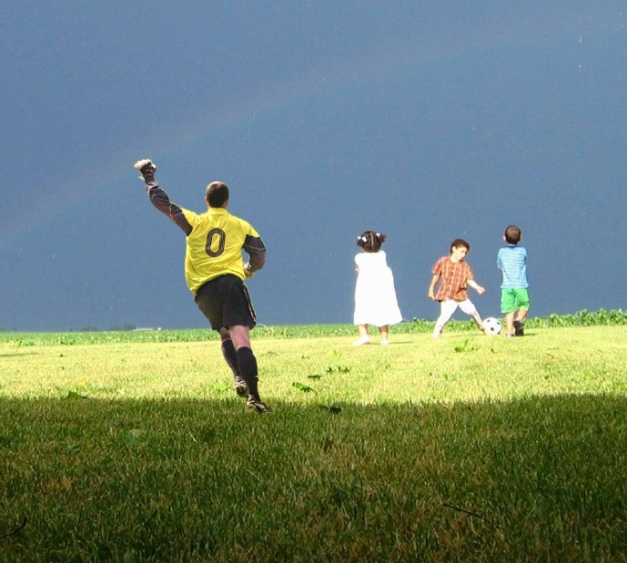
Results of Hybrid Cloning
MVC Cloning
Content-aware
Hybrid Cloning
Notes:
This is a football player pasted into the same target scene.
Through comparisons, we find that our method can efficiently produce more natural result than MVC and content-aware method.

Slide 27
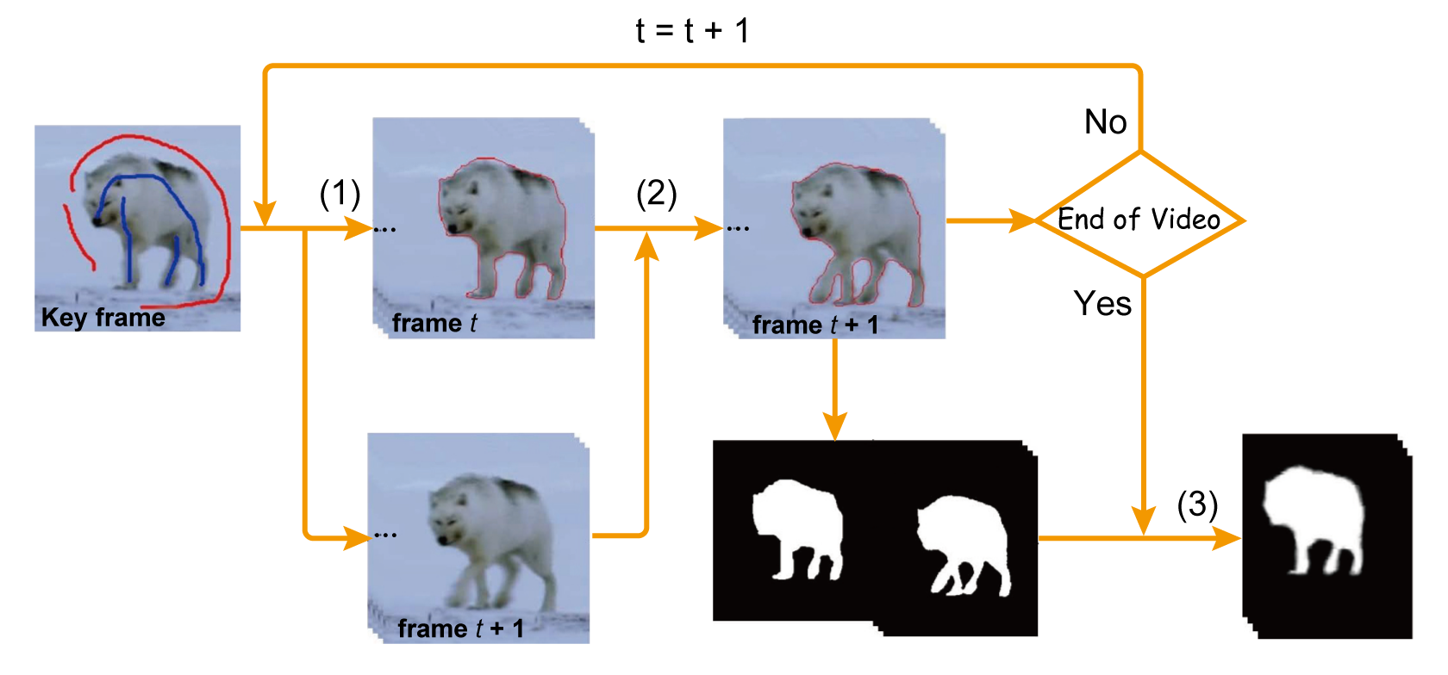
Application to video cloning
Extracting the foreground
Notes:
Given the fine performance of our image cloning, it is natural for us to apply it to video cloning. This task is usually divided into two steps: (1) extracting the foreground by video cutout. (2) blending with the background naturally.
The Video cutout is based on the state-of-the-art video Snapcut which has been transferred to Adobe After Effects. After we get the mask as output, coherent matting is used to get the soft matte. Similar to content-aware cloning, the matte is used to control the diffusion process, thus it does not need to be accurate.

Slide 28
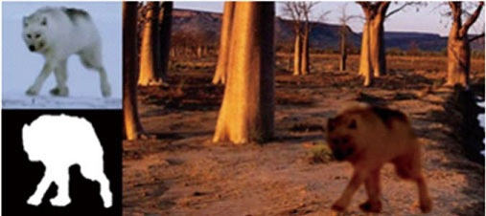
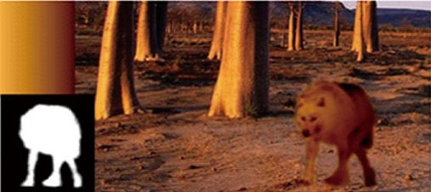
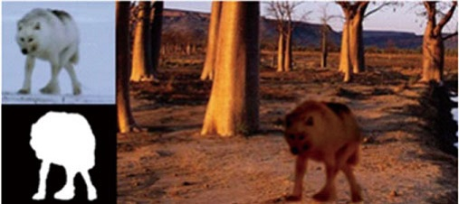
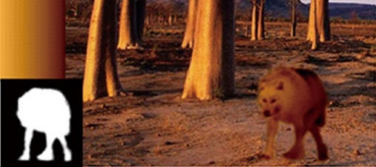
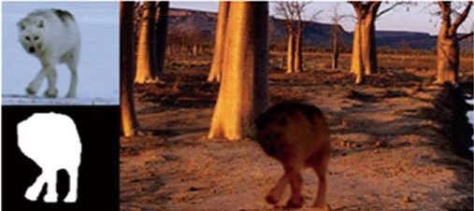
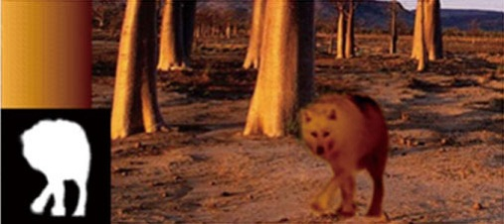
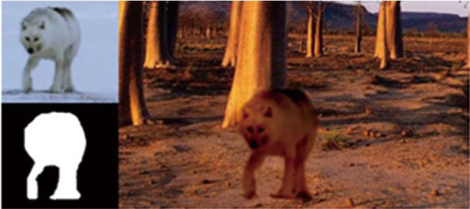
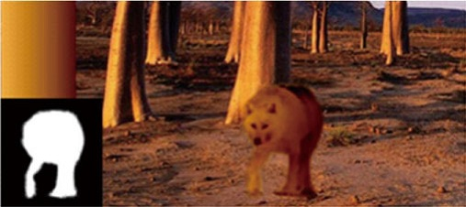
Application to video cloning
Blending with the background
Frame 7
Frame 15
Frame 21
Frame 28
Notes:
For every frame, the out boundary of the trimap is used as the cloning boundary, and the alpha matte of every frame can be used to control the diffusion of global and local features. When considering the global illumination condition, we assume that it does not change during the video cloning. By providing the global feature and alpha matte for every frame, our image cloning model can be used to paste the video object into the target scene seamlessly and naturally. The left column is the results using direct MVC-cloning, while the right column is the results by our environment-sensitive cloning method. Obviously, our results are more acceptable.

Slide 29
Limitations
The reference image is simple, which could not represent some complex target scene
The diffusion process does not take into account the shape of cloning boundary
Motion and boundary difference between frames is not considered in video cloning

Slide 30
Conclusion
Environment-Sensitive image cloning which combines the global and local features
Extract and represent the global feature of the target scene
Propose a general model for image cloning in different illumination conditions
An efficient MVC-based solution to composite images with hybrid boundary
Notes:
In conclusion, we proposed Environment-Sensitive image cloning which combines the global and local features
Extract and represent the global feature of the target scene
Propose a general model for image cloning in different illumination conditions
An efficient MVC-based solution to composite images with hybrid boundary

Slide 31
Future Work
Explore more effective methods to extract the global visual features and create more complex reference image
More effective methods to diffuse the global features into the cloned image
Roughly analyzing the geometric character of the foreground objects in image cloning
Consider the motion difference in application to video cloning
Notes:
In the future, we plan to do

Slide 32
Acknowledgement
We thank Prof. Hu for his encouragement and support
We thank Tao Chen for his inspiring chat with us
We thank Lin Cong, Weize Zhang for their help in writing and coding

Slide 33
Thank you
Notes:
Now it is the end of my talk, thanks for your attention

